Slide 1
CORPORATE TRAINING SYSTEM
SUPERVISOR: Mr. Nguyen Huy Hung
Team member: Le Phuc Thinh
Vo Thach Nguyen
Pham Chanh Hung
Dang The Anh

Slide 2
OUTLINE
Introduction
Implementation
Demostration
Values & Challenges

Slide 3

INTRODUCTION
1
Current Situation
2
Problems
3
Solution

Slide 4
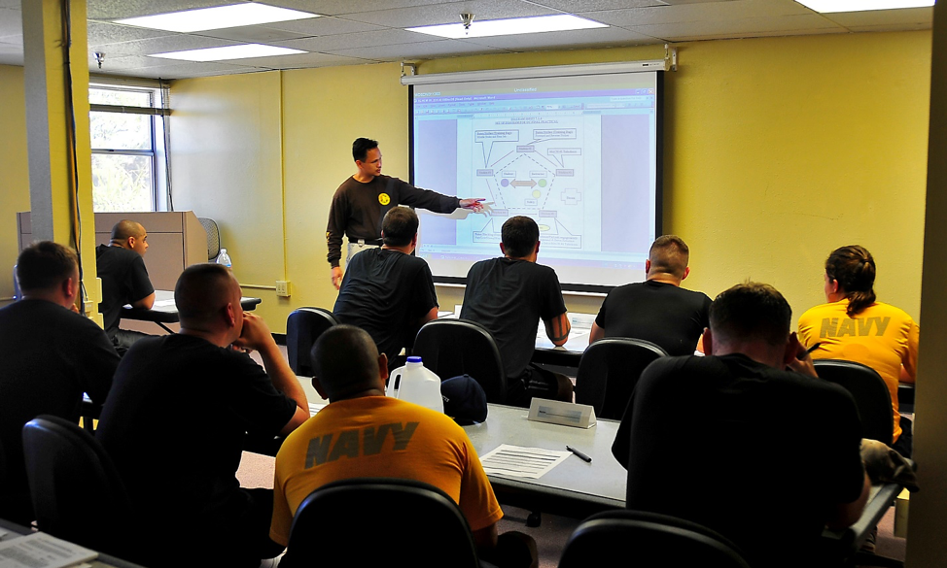
Current situation
Traditional Training
Lack of human resources to conduct meeting and courses
Trainers have to train repeatedly
Students cannot have flexible time to study

Slide 5

Current situation
Self-study
Lack of communication
Holes in knowledge
Knots in your head

Slide 7

Current situation
Share training program online
Lack of privacy on training courses
Loss of Control
User information can be exposed to third party

Slide 8

SOLUTIONS
Provide a system for corporations to train their employees with security and conveniences.
Analyze employees’ studies to make improvements base on results.
Corporations can manage their training plans and users participated in it with ease.

Slide 9

IMPLEMENTATION
1
System overview
2
Features
3
System architecture

Slide 10

SYSTEM OVERVIEW
Brand
Brand
Brand
Plan
Plan
Plan
Program
Program
Course
Course
Course

Slide 11
Course
Section
Section
Section
Lecture
Lecture

Slide 12
FEATURES
System Admin
Manage brands
Admin
Manage brand
Manage users
Manage plans
Manage programs
Manager
Manage skills
View report
Add/remove plan participants
Author
Manage course
Enroll course
Learner
Learn lecture
Take quiz

Slide 13
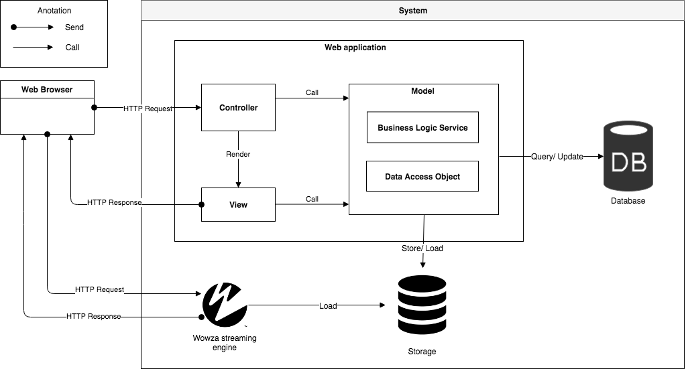
SYSTEM ARCHITECTURE

Slide 14

DEMONSTRATION

Slide 15
DEMO MANAGER: CREATE plan

Slide 16




PROCESS
1. Open manage plans page
2. Click create plan
Manager
Create plan popup
Manage plans page
3. Input information
4. Change plan image overview
Manage plan

Slide 17
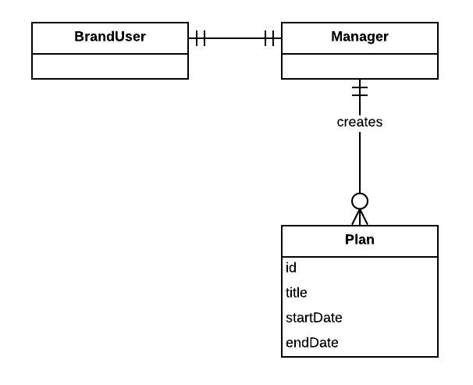
ENTITIes

Slide 18
DEMO MANAGER: CREATE PROGRAM

Slide 19
PROCESS
1. Choose specific plan
2. Click create program
Manager
Create program popup
Manage plan page
3. Input information

Slide 20
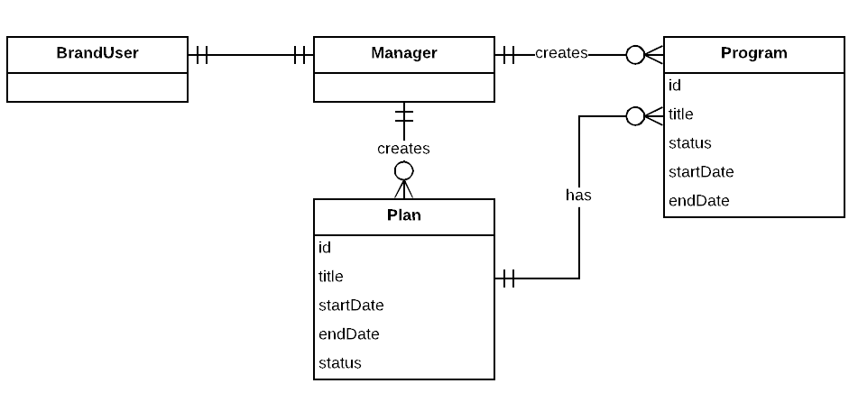
ENTITIes

Slide 21
DEMO MANAGER: ADD learner participant

Slide 22
PROCESS
1. Choose specific plan
2. Click add learner to plan
Manager
Learner list popup
Manage plan page
3. Choose learner

Slide 23
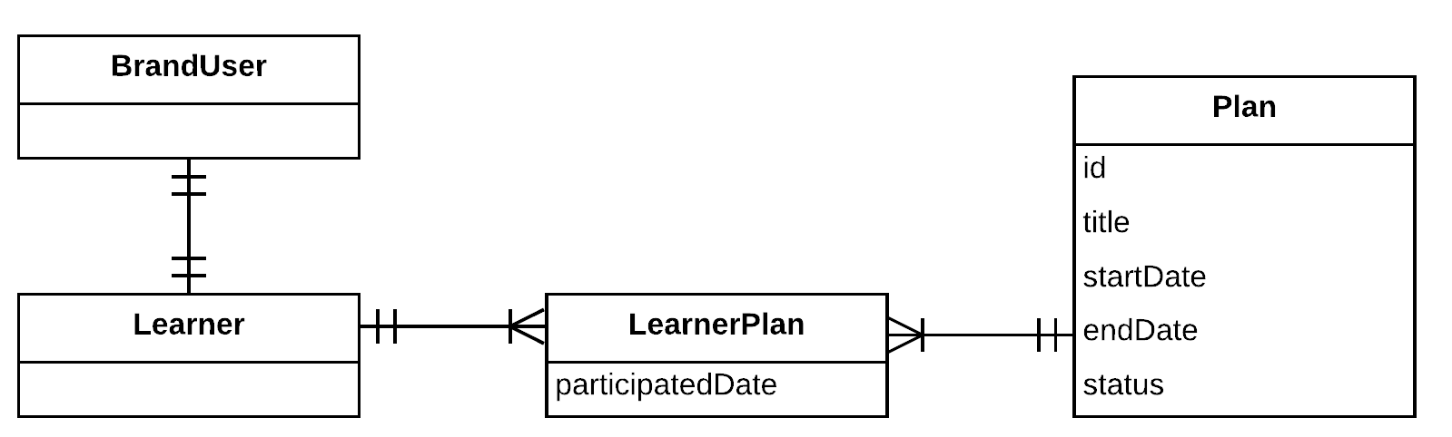
ENTITIes

Slide 24
DEMO MANAGER: VIEW LEARNER ACTIVITIES in plan

Slide 25
PROCESS
1. Open manage report page
2. Choose specific plan
Manager
Manage report
Plan report page
3. Choose learner

Slide 26
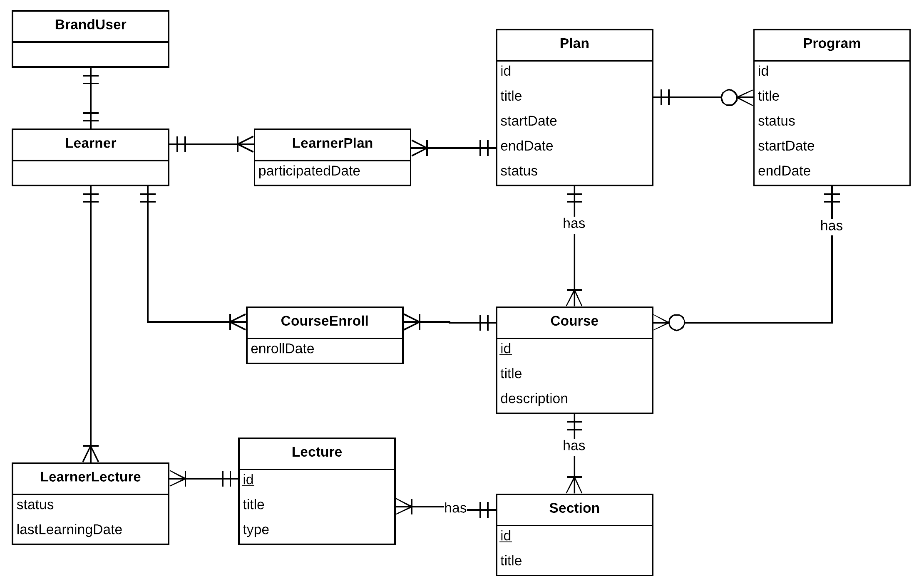
ENTITIes

Slide 27
DEMO author: CREATE COURSE

Slide 28

PROCESS
1. Open list plan
2. Create course
Author
Browser
Course
3. Fill information and click publish

Slide 29
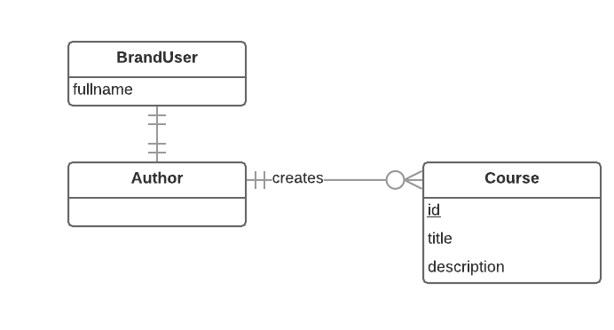
ENTITIes

Slide 30
DEMO author: CREATE LECTURE

Slide 31


PROCESS
1. Open my course list
2. Choose course
Author
Browser
Course
3. Choose section
5. Fill information and click publish
4. Create lecture
Lecture
Section
Notes:
Đầu tiên: tác giả bật traisy web app.
Tiếp theo: tác giả chọn khóa học trong danh sách khóa học của mình, sau đó tác giả bấm thêm bài học cho khóa học đó, , kế tiếp tác giả chỉnh sửa nội dung cho bài học
Cuối cùng: sau khi hoàn tất chỉnh sửa, tác giả lựa chọn “công khai” khóa học

Slide 32
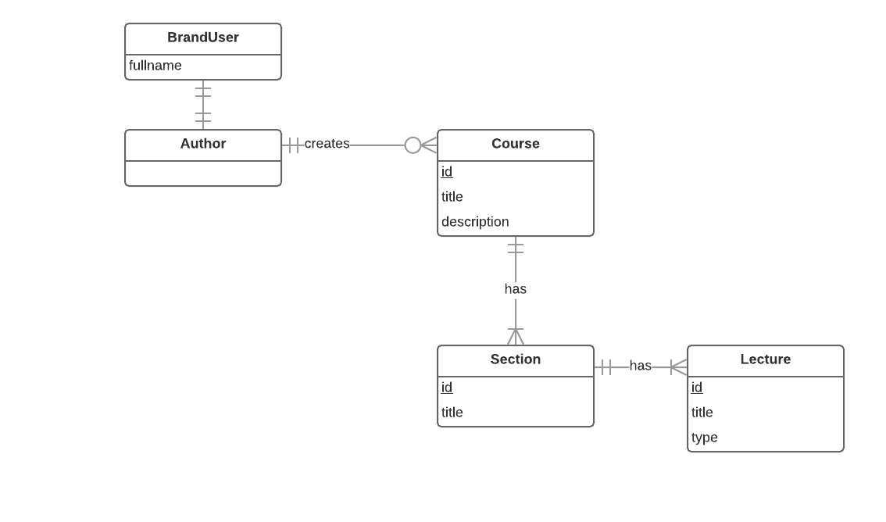
ENTITIes

Slide 33
DEMO author: CREATE quiz

Slide 34



PROCESS
1. Open my course list
2. Choose course
Author
Browser
Course
3. Choose section
6. Create answer
5. Create question
4. Create quiz
Answer
Question
Quiz
Section
Notes:
Đầu tiên: tác giả bật traisy web app.
Tiếp theo: tác giả chọn khóa học trong danh sách khóa học của mình, sau đó tác giả bấm thêm bài học cho khóa học đó, , kế tiếp tác giả chỉnh sửa nội dung cho bài học
Cuối cùng: sau khi hoàn tất chỉnh sửa, tác giả lựa chọn “công khai” khóa học

Slide 35
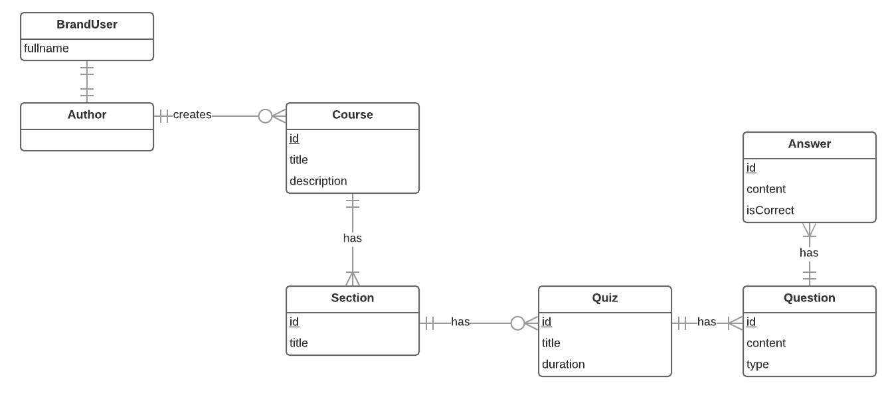
ENTITIes

Slide 36
DEMO LEARNER: LEARN LECTURE

Slide 37
PROCESS
1. Open course page
2. Learn lecture
Learner
Course information page
Lecture
3. Click finish learning lecture

Slide 38
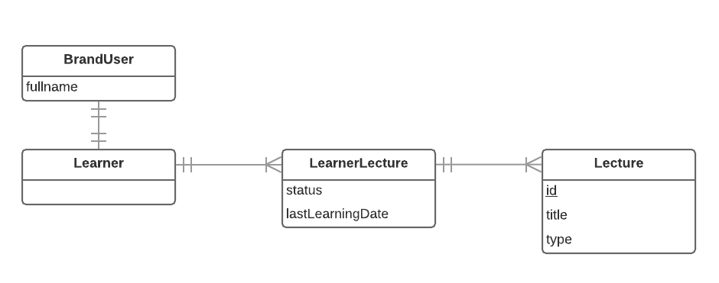
ENTITIes

Slide 39
DEMO LEARNER: TAKE QUIZ

Slide 40
PROCESS
1. Open course page
2. Take a quiz
Learner
Course information page
Quiz
3. Show result of quiz

Slide 41
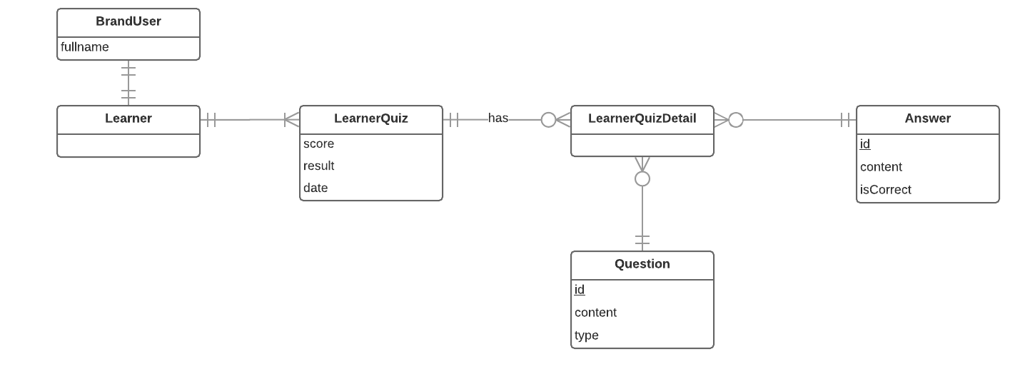
ENTITIes

Slide 42

VALUES
Tightness and clarity. There are different specific training plans, each consisting of programs and courses related to a particular field.
Monitor everything through reports or statistics.

Slide 43

CHALLENGES
Currently only supports the web platform
Limited learning resources

Slide 44

FUTURE PLANS
Develop and improve system on mobile platforms such as iOS, Android, ...
Expanse learning resource

Slide 45
THANK YOU FOR LISTENING

Slide 46


